Slide 1
Scientific Data Management with MXCuBE
Fredrik Bolmsten, on behalf of the KITS Group
Notes:
In my presentation I will explain the MAX IV data management strategy and its first implementation on the behalf on the KITS group.

Slide 2



Agenda
S
D
M
Notes:
My talk will make the emphasis of the relationship between MAX IV and the User, and only on the Data.

Slide 3

Notes:
Our motivation is to show that is not only a problem of storage. We want to make the User’s data safe.
The way how to do the work is not only technical. Value are important as well.

Slide 4
Simple as that?
Notes:
Big data, High through output is obviously a technical problem.
But a data management should also include other services as transparent as possible. Meta data, processing, data transfer.

Slide 5
SDM
Data Policy
Scope
Architecture
Data Model
Improvement
Notes:
From proposal to publish (what do MAX IV budget for? Where are MAX IV concerned?.. bringing in our external efforts and vision)

Slide 6



Data Policy
owns
stores
are

Slide 7
Concern of the Data
Submit proposal
Proposal review
Plan Visit
+ Arrival
Data Collection
Scientific Results
Analysis
Data Portal
S
D
Data
Collection
& Analysis
User Office
M
Notes:
Initially for data generation but our concern is about the all lifecycle as the result is important as well

Slide 8
Data and Service Interoperability
MAX IV integrates different software at different stages.
The integration is either in-house or by file. Use HDF5 as a standard format.
User Office
Data Acquisition
Data Storage
Data portal
Data Analysis
Data Visualisation
Data Assessment
(Meta) Data catalogue

Slide 9
Workflow
Authenticate as user
Choose the proposal
Set the path of the proposal to the software that produce data
Launch the acquisition
Process the data
Read the data from anywhere

Slide 10









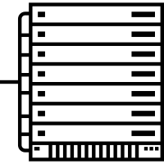










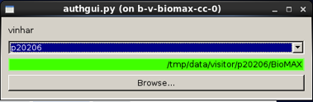



Architecture
Under the hood
Data Portal
Central Storage
Central Computing
DUO
Active
Directory
Control Server
Beamline
Workstation
Notes:
Come up with this architecture where you can see that the Directory is the central and critical component

Slide 12




User Interfaces and one login
Data Portal
DUO
Data Collection
Central Storage
DUO
login
High Performance Computing
Proposal
login

Slide 13
Beamline experimental station
Authentication
Group login during beamline shift
Personal login for:
Data Analysis
Data Portal
DUO
…

Slide 14
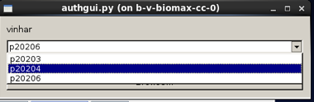











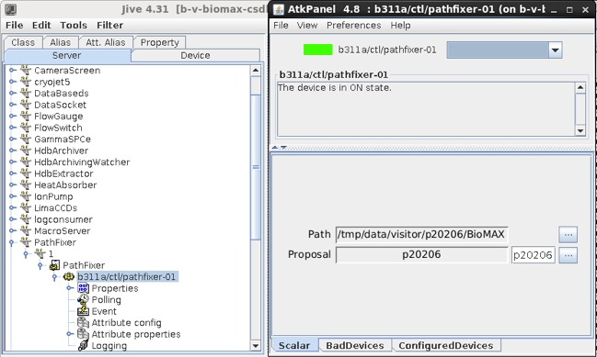
Data Collection - Proposal choice
Control Server

Slide 15
Ownership and Access
/data/(user-type)/(beamline)/(proposal)/(visit)/raw
The (user-type) includes visitors (bread and butter academic users), staff (MAX IV staff) and proprietary (mostly industrial users with a different need for data security).
The (visit) should begin with the date when the first shift starts.
In addition to /raw there will be a /process folder at the same level with full access.
path: | /data/visitor | /beamline | /proposal | /visit/raw
owner | root | beamline-services | beamline-services | beamline-services
group | root | beamline-staff | proposal-group | proposal-group
posix | 2755 | 2775 or 2755* | 2750 | 2770
 | static | static | dynamically created | dynamically created
 | created on the central storage | created on the central storage for each beamline | dynamically created by a service account | dynamically created by a service account

Slide 16
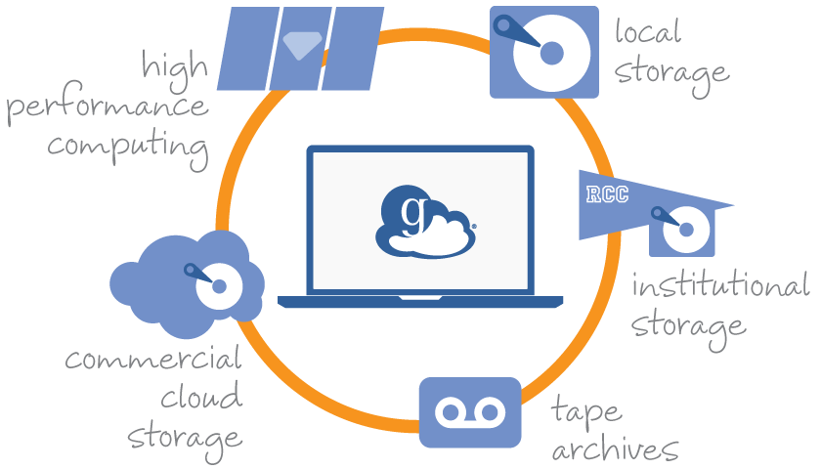
Data Portal
A user’s data access rights are determined by proposal she belongs to
Independent whether connected inside or outside MAX IV
Within the facility, the storage directory can be mounted via NFS or SMB
Outside facility, a Data Transfer System will provide fast data movement capability
Globus/gridftp services
MAX IV is directly connected to SUNET
10Gbps initially, 100Gbps later
Courtesy of A.Barcsyk

Slide 17

Goal of Improvement
Reduce Result lead time
R
S
D
M
As much value as possible
Notes:
The ultimate goal is to reduce the lead time between the sample collection and the expected result

Slide 18
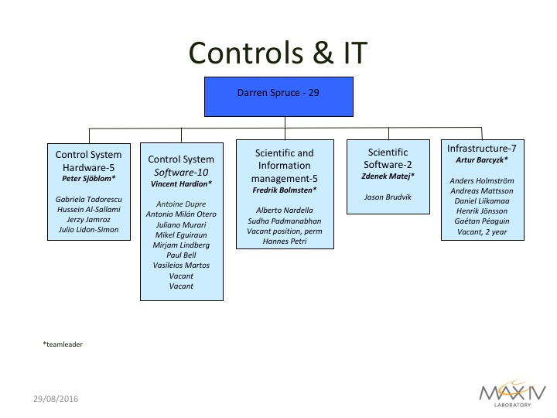

Slide 19
Questions?
Thanks for your attention

